Slide 1
PARENTS FOR PARENTS CLASS
TAKING THINGS one day at a time

Slide 2
Parent Partners
Parent Partners are moms and dads just like you whose children were removed from their care. These parents worked to get their kids back home, and they know how tough it can be.
Parent Partners are not lawyers, but they know a lot about what happens when kids are taken away.
They can't give legal advice, but they can help you understand what's going on and share their own experiences.

Slide 3
Class Format
Receive a Parent Handbook and learn how to use it
Learn about the court process and timeline of a typical case
Learn about the people in court and what they do
Go over frequently asked questions

Slide 4
Parent Handbook
The Parent Handbook was developed by Parent Partners
They struggled to make their way through the court process and wanted to make it easier for other parents to understand what was happening
The Parent Handbook was made so that you can stay organized, understand what is happening, ask questions, and advocate for yourself and your family

Slide 5
Removal
There are two ways a child can be removed from a home:
#1 when a police officer finds a child in extreme danger and removes them to keep them from being seriously injured (called imminent danger)
#2 when the Department of Health and Welfare investigates and asks a judge to sign an order removing a child from an unsafe situation
  This includes Rule 16 Expansion Orders where a juvenile in a criminal case is referred to child protection

Slide 6
Month 1
Go to court within 48 hours of the child’s removal for Shelter Care Hearing
  The judge will decide if a child needs to be placed in a safe place, like foster care, for a short period of time
    Children under 12 are assigned a guardian ad litem (GAL)
    Children over 12 may be assigned their own lawyer, they may also have a GAL
    You will be assigned your own lawyer if you cannot afford one
  Someone from Health and Welfare is assigned to your case (case worker)
  Your case worker will start planning visits to meet with the child
You can start working on any known safety issues at home and seek help for any mental health or drug problems

Slide 7
Month 2
Go to court about 30 days later for the Adjudicatory Hearing.
  Judge determines whether to give full custody of your child to Health and Welfare, or back to you, while the case is ongoing.
Meet with case worker:
  Family Meeting: what resources and support you need to provide a safe home for your child
  Relative search and engagement: to find relatives who may be able to care for your child
  Safety Plan: a list of safety issues that need to be addressed
  Case Plan: a list of things that need to be done before your case can close
Visits with your child begin
Case worker meets with your child
GAL meets with your child
These visits should continue every month until your case closes

Slide 8
Month 3-6
Month 3:
You go to court again for a Case Plan Hearing to finalize your Case Plan
You will start working the steps in your Case Plan
Month 4-5:
You may go to court again so the judge can check in and see how you are doing; this is called a Status Hearing
Month 6:
You go to court again to talk about your plan. This is called the 6-Month Review Hearing

Slide 9
Month 12+
Month 12:
You go to court again for a Permanency Hearing
The judge will decide where your child will live permanently
Month 15+:
If the child has remained out of your home for the last 15 of the most recent 22 months you may lose your ability to be your child(s) “legal parent”
You will return to court for a Termination of Parental Rights Hearing and your legal rights as a parent will be severed

Slide 10
Visitation
In most cases visits between you and your child usually start with supervised visitation. This is where you will visit with your child in a neutral third-party location with someone supervising.
Over time, if there are no issues this will turn into unsupervised visitation.

Slide 11
Home Visits
A case worker may come to your home to check and make sure it is a safe environment.
The goal of this is to check that you have a safe home for the child to return to and that you and your child have a healthy connection.
It can be intimidating to have someone come to your home at this point because you probably feel like you are being judged but know that you don’t have to be perfect to be a parent, and they just want to check to make sure that the home is safe for your child.

Slide 12
Extended Home Visits
An Extended Home Visit is any period over 2 days where you have unsupervised visitation with your child.
Extended home visits can last up to 6 months, but extensions can be granted if the court says it’s okay. If that happens you will be asked to go to court every 42 days so the court can review progress.

Slide 13
Protective Supervision
Protective Supervision is also where your child is sent home and legally in your custody, but subject to supervision by the Department of Health and Welfare.

Slide 14
Types of Permanency
  Reunification: means that your child returns home to you
  Termination of parental rights and adoption: this means that you no longer have any legal rights to your child and the child can be adopted by another family
  Guardianship: this is typically where a family member takes care of your child and has legal rights to make medical and educational decisions about their future
  APPLA: For children 16 or older: Another Planned Permanent Living Arrangement (APPLA), this is a long-term plan for older kids that may include long term foster care

Slide 15
Concurrent Planning
The Case Plan contains two different plans for where your child will live forever: best case scenario (primary plan) & worst case scenario (secondary plan)
Example:
Primary Plan: Reunification
Secondary Plan: Guardianship
Case workers will work on both plans at the same time

Slide 16
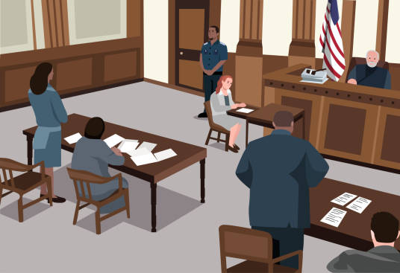
  Role of People in Court

Slide 17
Questions You May Have
  When can I see my kids?
  Your case worker should start visits with your child in the first month (if it is safe to do so)
  You should continue to have visits with your child at least every month until your case is closed
  If you cannot attend a visit, call your caseworker as soon as you know

Slide 18
Questions You May Have
  When will I get my kids back home?
  Your child can return home when the judge decides that the safety issues are addressed, and it is safe for them to return.
  Typically, this is when the Safety Plan and Case Plan are complete, but it may happen sooner

Slide 19
Questions You May Have
  What happens when my kids come home?
  Health and Welfare will stop by your home to check that you have a safe place for your children to return to.
  They may do checks until your case has closed.

Slide 20
Questions You May Have
  Who do I talk to if I have questions about my case?
  Contact your lawyer (meet in person, email or call them) to ask about any questions you have about your case or the court process in general.
  Your lawyer is there to speak for you in court and to make sure that you understand the process and are heard.

Slide 21
Questions You May Have
What if I have a complaint?
  The office of Health and Human Services Ombudsman was created to field complaints about the child welfare process
  The ombudsman will accept complaints about services or an agency’s behavior that violate state rule, law or policy, as well as services that were imposed without adequate reason or were based on irrelevant, immaterial or erroneous grounds.
  This office is still being staffed and created, but once established, will be the centralized location for complaints

Slide 22
Other Questions?

Slide 23


